Slide 1
College Technical Math 1
Unit 9: Geometry

Slide 2
Unit 9
17.1: Lines and Angles
17.2: Polygons
17.3: Circles and Radians
17.4: Volume and Surface Area

Slide 3
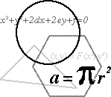
Geometry
Geometry is the study of size, shape, position and other properties of the objects around us.

Slide 4
Geometry
To begin our study of some of the principles of geometry, we define the common figures and there symbolic representation.

Slide 5
Geometry
A point is a location or position in space. Points do not have any size or dimensions.
Diagram Symbol
A
Point A

Slide 6

Geometry
A line is an infinite set of points. A line extends in both directions indefinitely, has length, but not width.
Diagram Symbol
$$\overset{⃡}{AB}$$
B
A
(two points define a line)

Slide 7

Geometry
A ray consists of a point on a line and all of the points of the line on one side of the point.
Diagram Symbol
Endpoint
$$\vec{AB}$$
B
A
(the direction of the arrow is important)

Slide 8

Geometry
A line segment is a part of a line.
Diagram Symbol
$$\overline{AB}$$
B
A

Slide 9

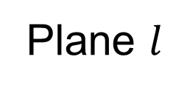
Geometry
A plane is a flat, smooth surface that extends indefinitely in all directions.
Diagram Symbol
Plane $l$
$$l$$

Slide 10
Geometry
C T M
Name the line two different ways.
$$\overset{⃡}{CT} \overset{⃡}{CM} \overset{⃡}{TM} \overset{⃡}{MC} \overset{⃡}{TC} \overset{⃡}{MT}$$

Slide 11

Geometry
C T M
Name a ray with an endpoint of T that contains M.
$$\vec{TM}$$

Slide 12

Geometry
C T M
Name the line segment that contains C and T in two different ways.
$$\overline{CT} \overline{TC}$$

Slide 13
Geometry
An angle is a figure formed by two rays that share a common endpoint, called the vertex. The rays are called the sides or legs of the angle
A
C
Vertex
B

Slide 14


Geometry
An angle is named using a single lower case letter, a number, the vertex, or by three letters with the vertex in the middle.
A
$$∠1 ∠B ∠ABC ∠CBA$$
$$1$$
C
B

Slide 15
Geometry
An angle can also be formed by the rotation of a single ray.
Initial side (ray)

Slide 16
Geometry
An angle can also be formed by the rotation of a single ray.
Initial side (ray)

Slide 17
Geometry
An angle can also be formed by the rotation of a single ray.
Terminal side (ray)
Initial side (ray)
Rotating counter-clockwise is defined as positive

Slide 18
Geometry
An angle can also be formed by the rotation of a single ray.
Initial side (ray)

Slide 19
Geometry
An angle can also be formed by the rotation of a single ray.
Rotating clockwise is defined as negative
Initial side (ray)
Terminal side (ray)

Slide 20
Degrees
A full rotation of a ray creates a circle.

Slide 21
Degrees
This fact helped define one of the units used to measure an angle.

Slide 22
Degrees
The Babylonian society is given this credit. Here is how they derived the unit.

Slide 23
Degrees
Place equilateral triangles into the circle.

Slide 24
Degrees
The Babylonians used a base 60 number system.

Slide 25
Degrees
The Babylonians used a base 60 number system.
They divided each vertex of the triangle into 60 equal pieces.

Slide 26
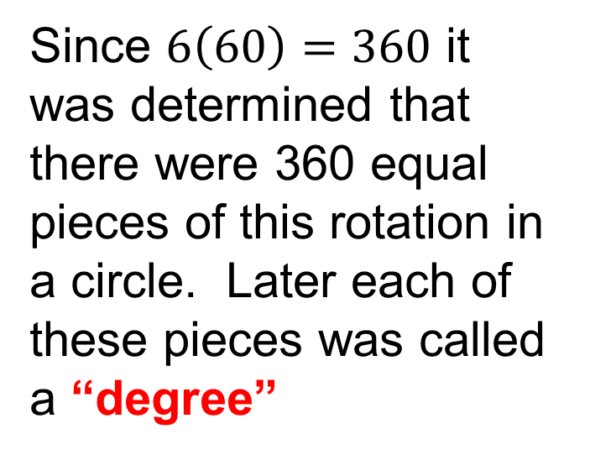
Degrees
Since $6\left(60\right)=360$ it was determined that there were 360 equal pieces of this rotation in a circle. Later each of these pieces was called a “degree”

Slide 27
Degrees
DD: Degree – Decimal notation º
Each degree is divided into tenths, hundredths, thousandths, etc...

Slide 28
Degrees
DMS: Degree – Minute – Second notation º ‘ “
Each degree is divided into 60 equal parts called minutes. The abbreviation for minutes is ‘.
Each minute is divided into 60 equal parts called seconds. The abbreviation for seconds is “.

Slide 29
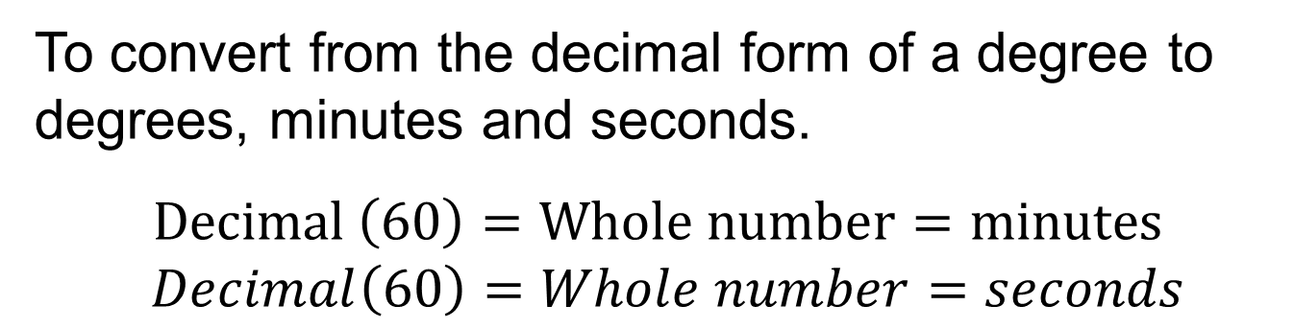
Degrees
To convert from the decimal form of a degree to degrees, minutes and seconds.
$Decimal \left(60\right)=Whole number=minutes$
$Decimal\left(60\right)=Whole number=seconds$
Some calculators are equipped with the ability to do this conversion:
DD►DMS
2nd
=
º ꞌ ꞌꞌ

Slide 30
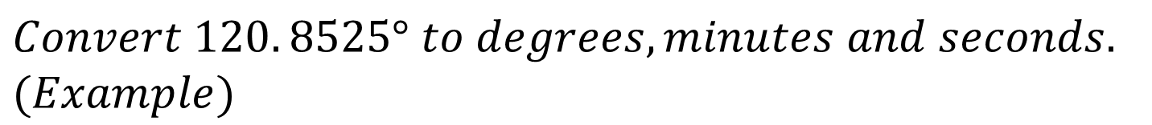



Degrees
$Convert 120. 8525° to degrees, minutes and seconds.$
$(Example)$
$$.8525 \left(60\right)=51. 15′$$
$$.15 \left(60\right)=9"$$
$$120.8525° = 120°{51}^{′}9"$$

Slide 31

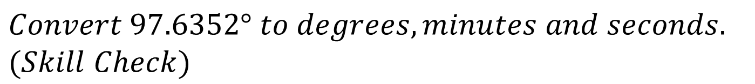
Degrees
$Convert 97.6352° to degrees, minutes and seconds.$
$(Skill Check)$
$$97°{38}^{′}6.72"$$

Slide 32
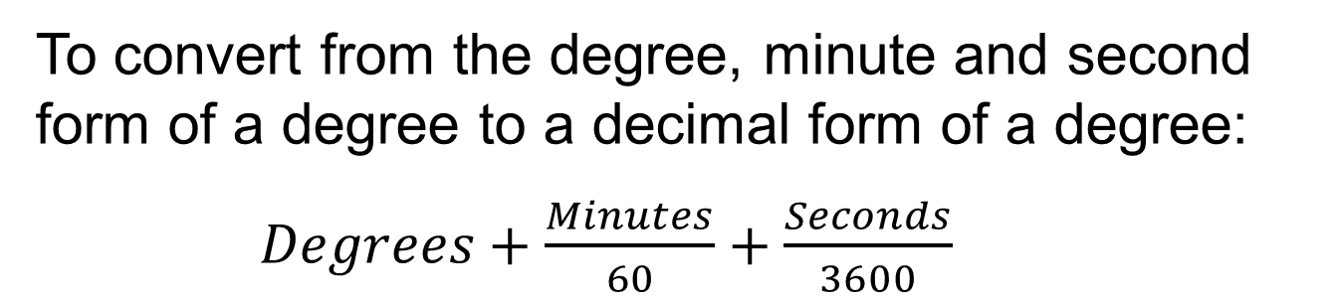
Degrees
To convert from the degree, minute and second form of a degree to a decimal form of a degree:
$Degrees+\frac{Minutes}{60}+\frac{Seconds}{3600}$
Some calculators are equipped with the ability to do this conversion.
DMS►DD
2nd
+
º ꞌ ꞌꞌ

Slide 33
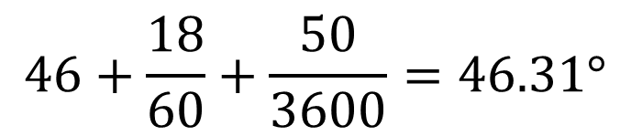
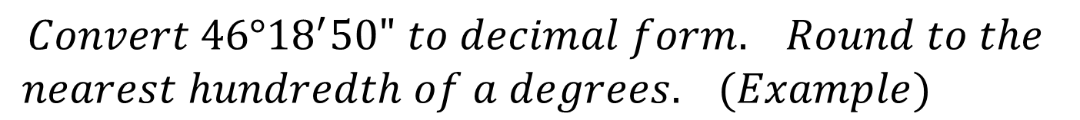
Degrees
$$Convert 46°{18}^{′}50" to decimal form. Round to the$$
$nearest hundredth of a degrees. (Example)$
$$46+\frac{18}{60}+\frac{50}{3600}=46.31°$$

Slide 34
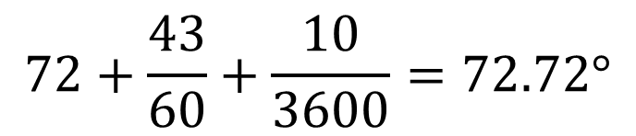
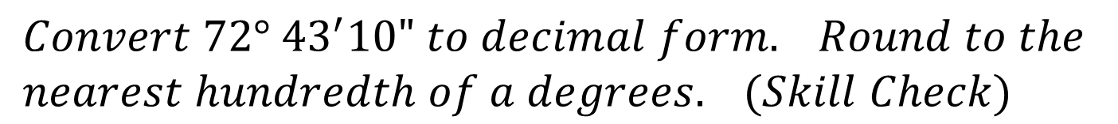
Degrees
$$Convert 72° {43}^{′}10" to decimal form. Round to the$$
$nearest hundredth of a degrees. (Skill Check)$
$$72+\frac{43}{60}+\frac{10}{3600}=72.72°$$

Slide 35
Angle Measurements
The measurement of an angle is defined as the amount of rotation from the initial side to the terminal side.
Using degrees as our measurement scale, we have the following definitions.

Slide 36

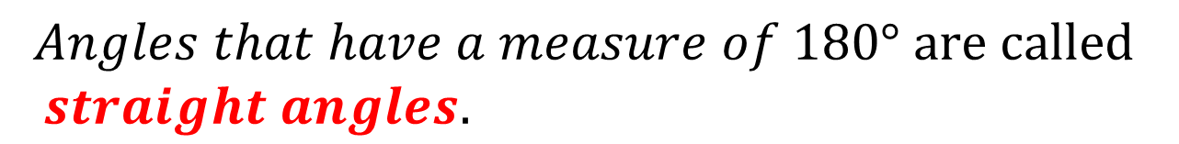
Angle Measurements
$$Angles that have a measure of 180° are called$$
$straight angles.$
$$180°$$

Slide 37

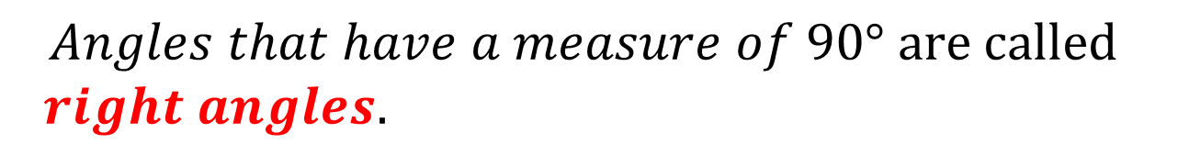
Angle Measurements
$$Angles that have a measure of 90° are called$$
$right angles.$
$$90°$$

Slide 38
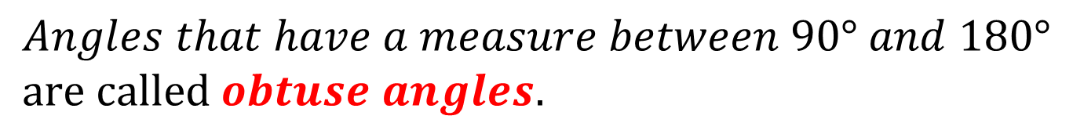
Angle Measurements
$$Angles that have a measure between 90° and 180°$$
$are called obtuse angles.$

Slide 39
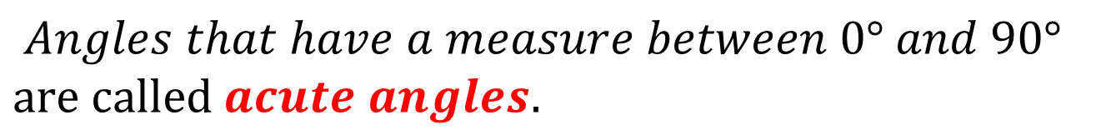
Angle Measurements
$$Angles that have a measure between 0° and 90°$$
$are called acute angles.$

Slide 40
Angle Measurements
Classify each angle measure as acute, right, obtuse or straight. (Examples)
$$a) 24° acute$$
$$b) 180° straight$$
$$c) 116° obtuse$$

Slide 41
Angle Measurements
Classify each angle measure as acute, right, obtuse or straight. (Skill Check)
$$a) 90° right$$
$$b) 92° obtuse$$
$$c) 4° acute$$

Slide 42

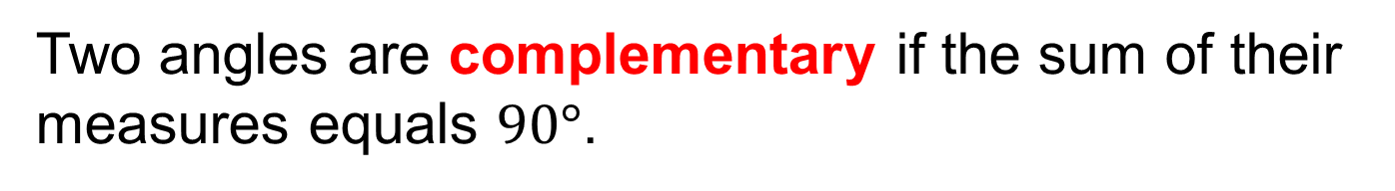
Angle Measurements
Two angles are complementary if the sum of their measures equals $90°$.
$$m∠1+m∠2=90$$

Slide 43

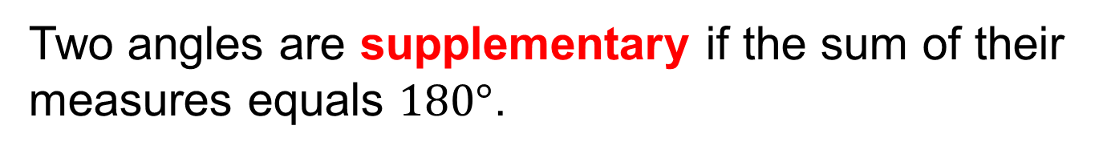
Angle Measurements
Two angles are supplementary if the sum of their measures equals $180°$.
$$m∠1+m∠2=180$$

Slide 44


Angle Measurements
Determine if each angle pair are complementary, supplementary or neither. (Examples)
$$a) 47°, 43°$$
$$47+43=90 Complementary angles$$
$$b) 56°, 124°$$
$$56+124=180 Supplementary angles$$

Slide 45



Angle Measurements
Determine if each angle pair are complementary, supplementary or neither. (Examples)
$$c) 27°, 53°$$
$$27+53=80 Neither$$
$$d) 104.7°, 75.3°$$
$$104.7+75.3=180 Supplementary angles$$

Slide 46
Angle Measurements
Determine if each angle pair are complementary, supplementary or neither. (Skill Check)
$$a) 42°,80° Neither$$
$$b) 17°,73° Complementary$$
$$c) 142°,38° Supplementary$$
$$d) 52°,48° Neither$$

Slide 47
Lines and Angles
When two or more lines intersect, angles are formed. We will now discuss the relationships between these geometric figures.

Slide 48




Lines and Angles
Adjacent angles – angles that share a common side
$$∠1 and ∠2$$
2
$$∠1 and ∠4$$
1
3
4
$$∠2 and ∠3$$
$$∠3 and ∠4$$

Slide 49




Lines and Angles
Linear pairs – adjacent angles that form a straight angle
$$∠1 and ∠2$$
2
$$∠1 and ∠4$$
1
3
4
$$∠2 and ∠3$$
$$∠3 and ∠4$$

Slide 50


Lines and Angles
Vertical angles– angles formed by intersecting lines that share a vertex. Vertical angles have the same measure.
2
$$∠1 and ∠3$$
1
3
4
$$∠2 and ∠4$$

Slide 51




Lines and Angles
Perpendicular lines – intersect to form four right angles.
$$m∠1=90$$
1
2
$$m∠2=90$$
4
3
$$m∠3=90$$
$$m∠4=90$$

Slide 52
Lines and Angles
A transversal is a line that intersects two or more lines in different points.
1
2
4
3
5
6
8
7

Slide 53
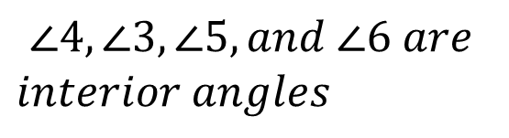
Lines and Angles
Interior angles are angles between the two lines intersected by the transversal.
1
2
$$∠4, ∠3, ∠5, and ∠6 are$$
$interior angles$
4
3
6
5
8
7

Slide 54
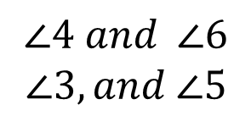
Lines and Angles
Alternate interior angles are interior angles on opposite sides of the transversal.
1
2
4
3
$$∠4 and ∠6$$
$$∠3, and ∠5$$
6
5
8
7

Slide 55
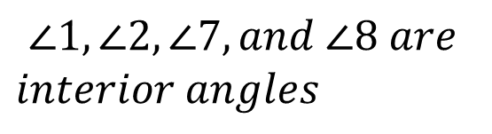
Lines and Angles
Exterior angles are angles outside of the two lines intersected by the transversal.
1
2
$$∠1, ∠2, ∠7, and ∠8 are$$
$interior angles$
4
3
6
5
8
7

Slide 56
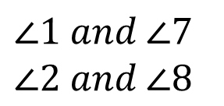
Lines and Angles
Alternate exterior angles are exterior angles on the opposite sides of the transversal.
1
2
$∠1 and ∠7$
$∠2 and ∠8$
4
3
6
5
8
7

Slide 57




Lines and Angles
An exterior and interior angle on the same side of the transversal are called corresponding angles..
1
2
$$∠1 and ∠5$$
4
3
$$∠4 and ∠8$$
$$∠2 and ∠6$$
6
$$∠3 and ∠7$$
5
8
7

Slide 58
Lines and Angles
When two parallel lines are intersected by a transversal, the following angle relationships are formed.
Corresponding angles are equal
Alternate interior angles are equal
Alternate exterior angles are equal
Same side interior angles are supplementary
Same side exterior angles are supplementary

Slide 59


Lines and Angles
Given that $l∥m$:
1
2
$$l$$
Corresponding angles are equal
4
3
5
6
$$m$$
8
7

Slide 60
Lines and Angles
Given that $l∥m$:
1
2
$$l$$
Alternate interior angles are equal
4
3
5
6
$$m$$
8
7

Slide 61
Lines and Angles
Given that $l∥m$:
1
2
$$l$$
Alternate exterior angles are equal
4
3
5
6
$$m$$
8
7

Slide 62
Lines and Angles
Given that $l∥m$:
1
2
$$l$$
Therefore... these angles are all equal.
4
3
5
6
$$m$$
8
7

Slide 63
Lines and Angles
Given that $l∥m$:
1
2
$$l$$
Same side interior angles are supplementary
4
3
5
6
$$m$$
8
7

Slide 64
Lines and Angles
Given that $l∥m$:
1
2
$$l$$
Same side exterior angles are supplementary
4
3
5
6
$$m$$
8
7

Slide 65
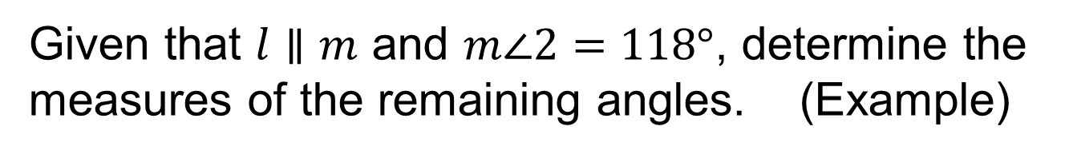
Lines and Angles
Given that $l∥m$ and $m∠2=118°$, determine the measures of the remaining angles. (Example)
1
2
$$l$$
4
3
5
6
$$m$$
8
7

Slide 66

Lines and Angles
Given that $l∥m$ and $m∠2=118°$, determine the measures of the remaining angles. (Example)
1
$$118°$$
$$l$$
4
3
5
6
$$m$$
8
7

Slide 67

Lines and Angles
Given that $l∥m$ and $m∠2=118°$, determine the measures of the remaining angles. (Example)
1
$$118°$$
$$l$$
$$118°$$
3
5
6
$$m$$
8
7

Slide 68

Lines and Angles
Given that $l∥m$ and $m∠2=118°$, determine the measures of the remaining angles. (Example)
$$62°$$
$$118°$$
$$l$$
$$118°$$
3
5
6
$$m$$
8
7

Slide 69

Lines and Angles
Given that $l∥m$ and $m∠2=118°$, determine the measures of the remaining angles. (Example)
$$62°$$
$$118°$$
$$l$$
$$118°$$
$$62°$$
5
6
$$m$$
8
7

Slide 70

Lines and Angles
Given that $l∥m$ and $m∠2=118°$, determine the measures of the remaining angles. (Example)
$$62°$$
$$118°$$
$$l$$
$$118°$$
$$62°$$
$$62°$$
6
$$m$$
8
7

Slide 71

Lines and Angles
Given that $l∥m$ and $m∠2=118°$, determine the measures of the remaining angles. (Example)
$$62°$$
$$118°$$
$$l$$
$$118°$$
$$62°$$
$$62°$$
$$118°$$
$$m$$
8
7

Slide 72

Lines and Angles
Given that $l∥m$ and $m∠2=118°$, determine the measures of the remaining angles. (Example)
$$62°$$
$$118°$$
$$l$$
$$118°$$
$$62°$$
$$62°$$
$$118°$$
$$m$$
$$118°$$
7

Slide 73

Lines and Angles
Given that $l∥m$ and $m∠2=118°$, determine the measures of the remaining angles. (Example)
$$62°$$
$$118°$$
$$l$$
$$118°$$
$$62°$$
$$62°$$
$$118°$$
$$m$$
$$118°$$
$$62°$$

Slide 74
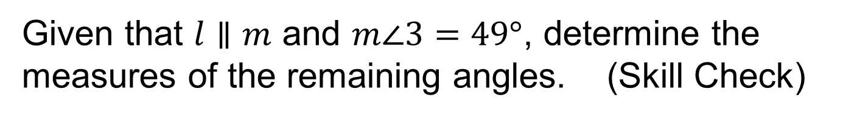
Lines and Angles
Given that $l∥m$ and $m∠3=49°$, determine the measures of the remaining angles. (Skill Check)
1
2
$$l$$
4
3
5
6
$$m$$
8
7

Slide 75








Lines and Angles
Given that $l∥m$ and $m∠3=49°$, determine the measures of the remaining angles. (Skill Check)
$$49°$$
$$131°$$
$$l$$
$$131°$$
$$49°$$
$$49°$$
$$131°$$
$$m$$
$$131°$$
$$49°$$

